Slide 1
Excel Assessment
Keerthanaa Arthanareeswaran
4286

Slide 2
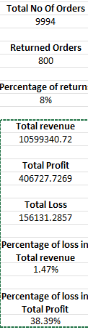
Problem Statement 1
Insights
The percentage of loss and percentage of profit in total revenue is calculated accordingly.
Inference
The return analysis is done here.
The percentage loss in total revenue is 1.47%
The percentage loss in total profit is 38.39%
Formula used –
COUNTA('Orders - copy'!A2:A9995)
SUMIFS('Orders’!V2:V9995,'Orders’!Y2:Y9995,"No")
Total profit/total revenue
A18/A12
Formula Used -

Slide 3
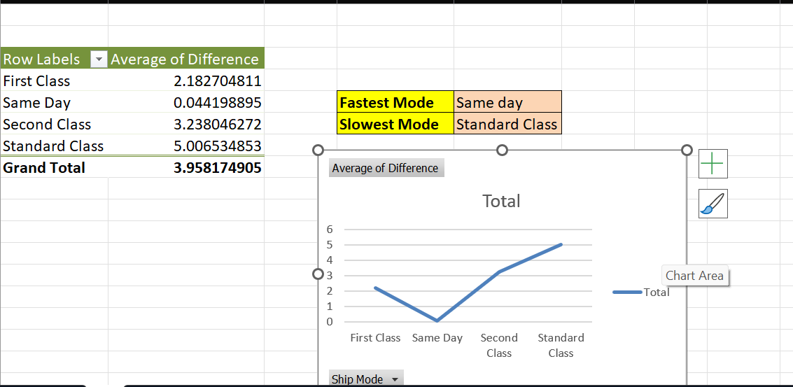
Problem Statement 2
Insights
The average of day difference between the shipment mode has been analysed.
The different ship modes are of 4 types.
The analysis help us to know the fastest delivery and slowest delivery modes
Inference
The Fastest mode of delivery is Same Day and the Slowest mode of delivery Is Standard Class according to the average in time difference
Formula Used – Difference between ship date and order date is taken as Difference in dates. Pivot Table is used for further analysis.

Slide 4
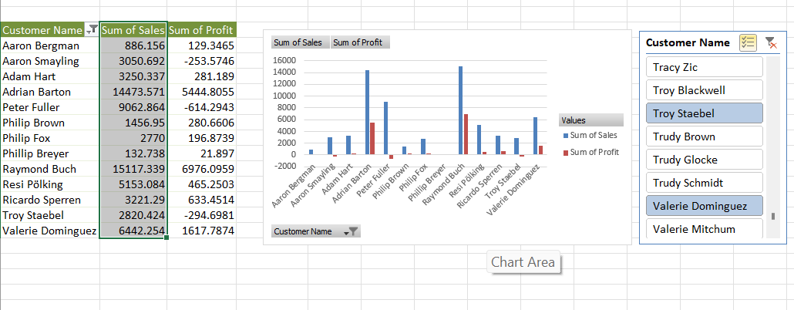
Problem Statement 3
Insights
The profitability of each customer is analysed here along with the sum of sales for each customer.
It gives the customer names with the most highest profits and lowest profits.
Inference
Raymond Buch has given the highest profit.
The lowest profit is given by Peter Fuller
Formula Used – Pivot Table is used for this analysis

Slide 5
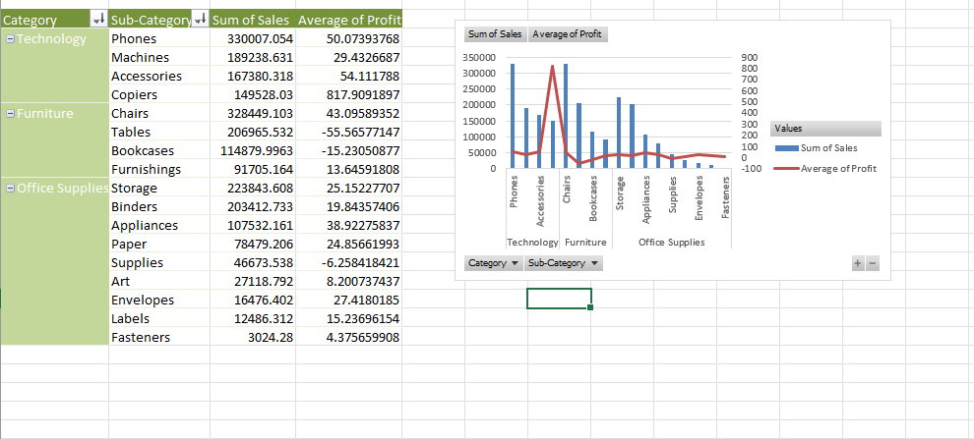
Problem Statement 4
Insights
The product Performance based on the category is analysed here.
The product with their category and sub-category is shown here.
The highest sum of sales and Average profit of those products are displayed.
The highest and the average sales and profit is based on category and sub-category of the product.
Formula Used – Pivot Table is used for analysis
Inference
The technology category has the highest sum of sales and average of profit.

Slide 6
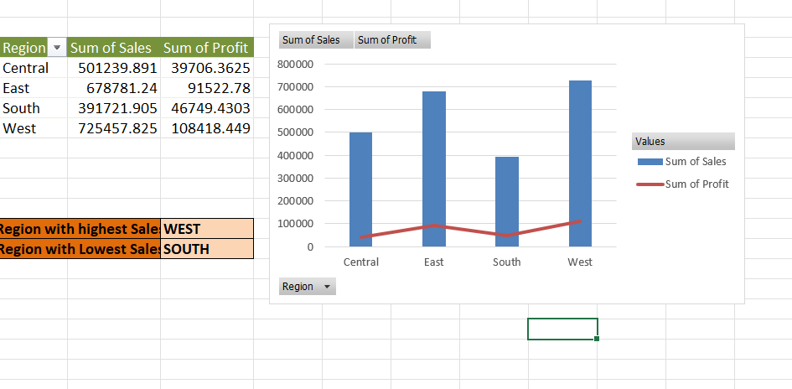
Problem Statement 5
Insights
The regional analysis gives us an insight about the sales and profit based on the region
It helps us to determine how the region wise sales can be improved.
It concentartes mainly on the 4 Regions Central,East,South and west.
Formula Used – Pivot Table is used for this analysis
Inference
The Region with highest sales is West
The region with lowest sales is South

Slide 7
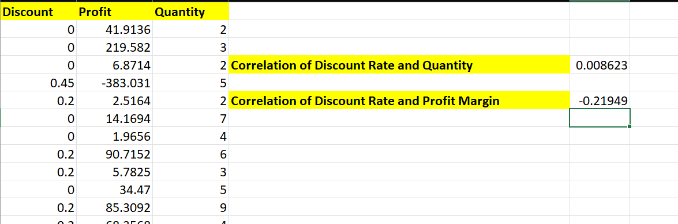
Problem Statement 6
Insights
The correlation is analysed between the discount rate and quantity.
The second correlation is done between Discount Rate and Profit Margin
The Correlation help us to know the Discount Analysis.
Formula Used – Pivot table has been used for this analysis
Inference
The correlation rate between discount rate and quantity is 0.008623
The correlation rate between discount rate and profit margin is -0.21949

Slide 8
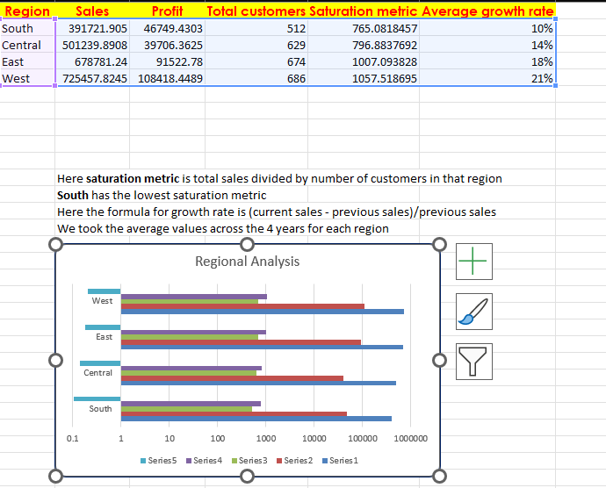
Problem Statement 7
Insights
The Market Expansion Analysis is done here.
The saturation metric and the average growth rate is done here.
It is done using the Segmentation of Region,Total no of customers
Inference
The saturation metric is total sales divided by thr no of customers in that region.
South has low saturation metric
Formula Used – total sales/no of customers

Slide 9
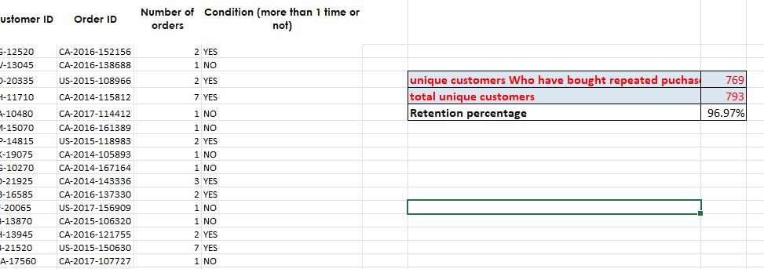
Problem Statement 8
Insights
The customer retention rate is analysed here.
The retention rate has certain formula which has been used here to calculate the retention rate.
The existing customers with repeated orders is also analysed here
Formula Used – The formula used here is sum and the retention rate formula is previous – current/previous * 100.
Inference
The unique customer who have bought repeated purchase is 769.
The retention percentage here is 96.97%

Slide 10
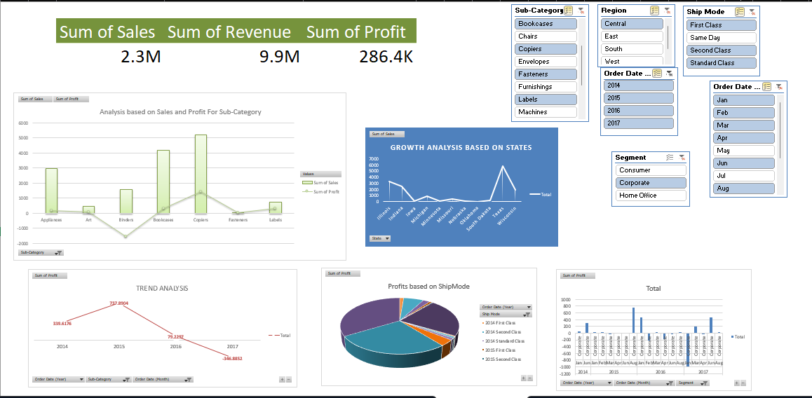
Problem Statement 9
Insights
The growth analysis based on states,analysis based on sales and profit for sub-category,Trend analysis,Profit based on ship mode and further more analysis is done in the dashboard.
Each one of them is connected to each other and give us a visual representation as per our conditions.
The conditions are given based on slicers.

